Slide 1








3
LESSONCOURSE
th
The 5 Dimension
EARENDEL PRO TRACK

Slide 2

Functionality
Five Main Stages
Select the stellar object from the app/ web interface.
The requested object is updated in the user’s database entry.
The telescope mount identifies a change in the current stellar object that is being observed, fetches its coordinates from the online database, and calculates the local coordinates.
The telescope will be turned towards the new object, without leveling or user interaction.
The mount maintains the track continuously.

Slide 3
Functionality
Main features
No leveling.
No reference is needed for the North.
No mathematics is involved.
Continuous tracking of the stellar object.

Slide 4
Functionality
Mechanical Design
Two main rotational degrees of freedom.
Metal design for increased strength and robustness.
Stepper motors with gear systems for increased resolution and precision.
Adjustable mechanism to host any kind of telescope.
Easy integration with existing tripods.

Slide 5
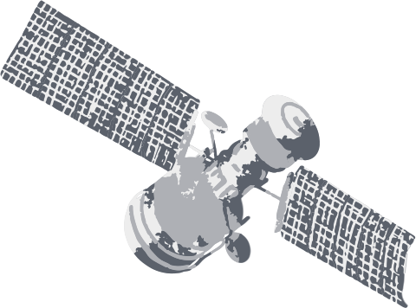



IOT
Intergration
1. Microcontroller
2. WiFi
3. Cloud database
4. App/ Web interface
5. Other additional features

Slide 6





Wi-Fi
The wireless connectivity through Wi-Fi enables communication between the telescope mount and the mobile app through a cloud database.
Database Integration
Online database to store coordinates of stars and planets.
Enables dynamic updates.
Ensures the users to have the latest data.
Microcontroller
ESP32 - Dual core microcontroller
Core 1 - Synchronous operations
Core 2 - Wireless communication
App / Web Interface
Seamless interface for the user for selecting and tracking celestial objects.
The app / web interface communicates to the telescope mount, guiding it to the desired location.
Other
GPS location of the mobile device.
Magnetometer to identify North.
Ensures precise movement and positioning of the telescope mount.

Slide 7

Interconnection Overview
The microcontroller is the central hub, orchestrating communication between the telescope mount, databases, and the mobile app.
WiFi facilitates data exchange, while the database integration ensures up-to-date information for accurate celestial tracking.

Slide 8
Scalability and Flexibility
Can be used with any typical small-scale telescopes.
Adjustable method to connect the telescope.
Compatible with any existing tripods.

Slide 9



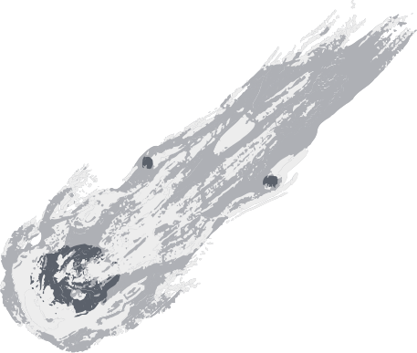
Market Analysis
The astronomy products market is thriving, driven by a growing fascination with the cosmos. Surveys also indicate a steady increase in stargazing and amateur astronomy activities globally.
Our Target Market Encompasses:
Competitor Analysis
Trends and Opportunities
Traditional telescope mounts are common, but IoT integration is new.
Explore emerging competitors for automated mounts.
Assess features, pricing, distribution, and customer feedback for insights.
The IoT revolutionizes stargazing for enthusiasts and education.
Demand grows for user-friendly astronomy tech.
Using social media and online platforms expands audience reach and product awareness.
Astro-enthusiasts
Academia
Astro-research organizations
Scope enthusiasts seeking upgrades.

Slide 10
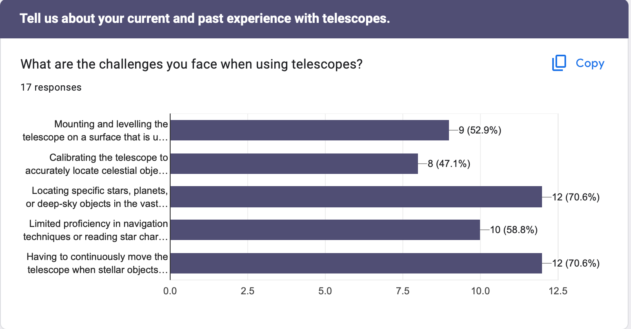

Slide 11
Market Analysis
The astronomy products market is thriving, driven by a growing fascination with the cosmos. Surveys also indicate a steady increase in stargazing and amateur astronomy activities globally.
Our Target Market Encompasses:
Competitor Analysis
Trends and Opportunities
Traditional telescope mounts are common, but IoT integration is new.
Explore emerging competitors for automated mounts.
Assess features, pricing, distribution, and customer feedback for insights.
The IoT revolutionizes stargazing for enthusiasts and education.
Demand grows for user-friendly astronomy tech.
Using social media and online platforms expands audience reach and product awareness.
Astro-enthusiasts
Academia
Astro-research organizations
Scope enthusiasts seeking upgrades.

Slide 12
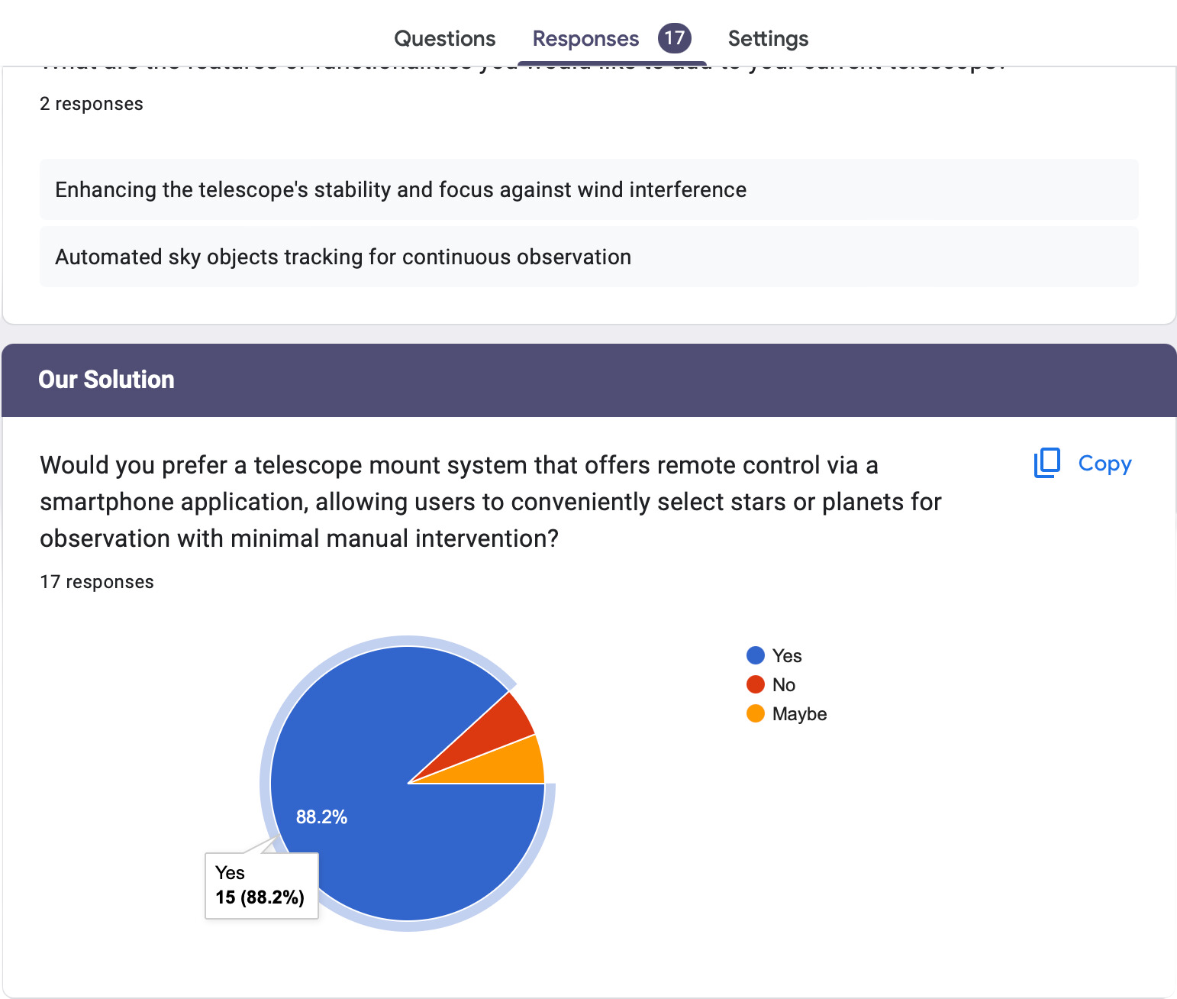

Slide 13

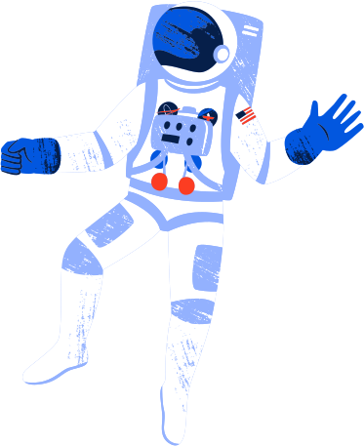
Business Plan
Planning to collaborate with engineers, astronomers, and IoT specialists to ensure our product meets industry standards and delivers user-friendly features.
Highlighted key features of the IOT-based mount:
Automatic alignment and tracking of celestial objects.
Compatibility
User-friendly mobile application
Precise rotation and leveling capabilities
Marketing & Sales Strategy:
Showcase the product at astronomy events, trade shows, and exhibitions.
Partner with astronomy clubs, schools, and online communities to broaden product reach.
Create informative content, tutorials, and demos highlighting product benefits.

Slide 14
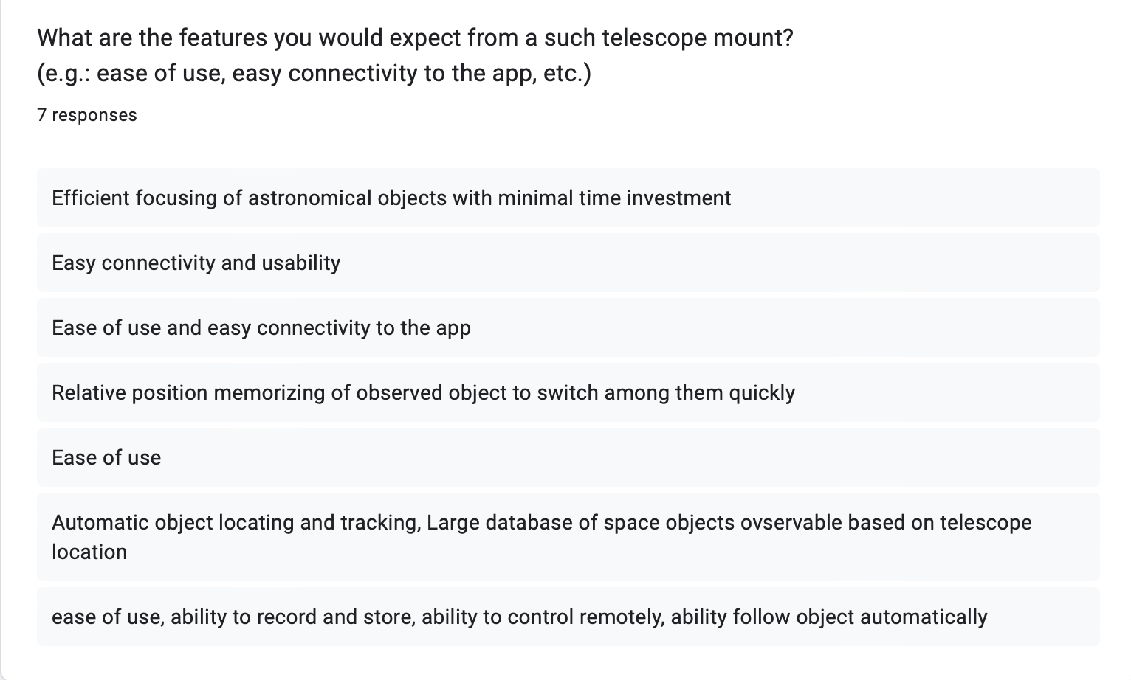

Slide 15
Business Plan
Planning to collaborate with engineers, astronomers, and IoT specialists to ensure our product meets industry standards and delivers user-friendly features.
Highlighted key features of the IOT-based mount:
Automatic alignment and tracking of celestial objects.
Compatibility
User-friendly mobile application
Precise rotation and leveling capabilities
Marketing & Sales Strategy:
Showcase the product at astronomy events, trade shows, and exhibitions.
Partner with astronomy clubs, schools, and online communities to broaden product reach.
Create informative content, tutorials, and demos highlighting product benefits.

Slide 16




SWOT Analysis
STRENGTHS
WEAKNESSES
OPPURTUNITIES
THREATS
User-friendly with auto leveling and rotation.
Integrated mobile app for easy control.
Standout IoT technology differentiates from traditional mounts.
Growing astronomy interest boosts product demand.
Partnering with clubs or institutions extends reach and credibility.
Competitors may offer similar or advanced products.
Meeting IoT and astronomy equipment standards could be challenging.
IoT may raise product costs.
Potential connectivity issues.

Slide 17


FMEA Analysis
Failures
Effect Analysis
Inaccurate celestial object tracking.
Potential missed events and frustration.
Misalignment issues impair observation.
Loss of remote control functionality.
Breakdown or wear of mechanical components such as gears, motors, or bearings.
Rotation Errors
IOT connectivity failure

Slide 18
Viability & Risk Assesment
Upward astronomy market trends.
Rising interest across individuals, schools, and institutions.
Future potential for a broader consumer base.
MARKET VIABILITY
Compatibility issues with telescopes.
Market trend shifts or declining astronomy interest.
Economic downturn affecting non-essential spending.
Safety standard compliance challenges.
Slow market adoption impacting revenue.
Unique IoT-enabled telescope mounts.
Enhancing appeal through telescope compatibility.
Convenient mobile app for user ease.
PRODUCT VIABILITY
Initial investment in R&D and production may be required.
Pricing strategy should be competitive yet profitable.
Revenue growth opportunities via upgrades, accessories, partnerships.
FINANCIAL VIABILITY
RISK ASSESMENT

Slide 19

Partner with telescope manufacturers for compatibility assurance.
Mitigation
Strategies
Adapt product to changing market trends.
Stay compliant with regulations and certifications.
Enhance customer support processes.
Refine marketing strategies through market research.

Slide 20


Execution Plan
SOFTWARE PROGRESS
HARDWARE DESIGN
BUSINESS PLAN
Mobile App: Completed, providing a user-friendly interface.
Database Integration: Successfully integrated, allowing real-time updates.
Component Selection: Completed, ensuring optimal performance.
Mechanical Design: In progress, aiming for universality and durability.
Assembly: Underway, combining precision mechanics with selected components.
The business plan is on track, aligning with expectations and ensuring the project's long-term success.

Slide 21
Thank you!

